Slide 1

Adyen ×
Formula 1
PARTNERSHIP PROPOSAL
Why F1 is the right platform for Adyen, and how to win in it
Prepared for [ADD: name, Chairman] · [ADD: date]
Notes:
Cover. Replace the [ADD] fields with the chairman's name and meeting date. Photo: Adyen 'Racing | Unified Payments' deck.

Slide 2





Adyen: creating financial efficiencies in F1
ADYEN'S BRIEF
ADYEN'S BRIEF DEFINES FOUR PRIORITIES FOR F1
Global brand
Client relationships
Commercial growth
One global programme
Show how Adyen's payments can power the financial business of F1
Host partners, merchants and senior decision makers
Win new deals, renew contracts and build pipeline
Unite local hosting across an initial 8–10 F1 races
Notes:
Source: Briefing - Adyen x Premium Experiences (Adyen), sections 1–5 and 7.
Adyen wants a global brand and hospitality proposition that shows how payments power its partners, strengthens relationships with partners and merchants, and supports new deals, renewals and pipeline. The initial target is 8–10 races. The audience includes senior and C-suite decision makers. Budget, race selection, guest tiers, delivery scope and specific KPIs remain to be confirmed by Adyen.

Slide 3
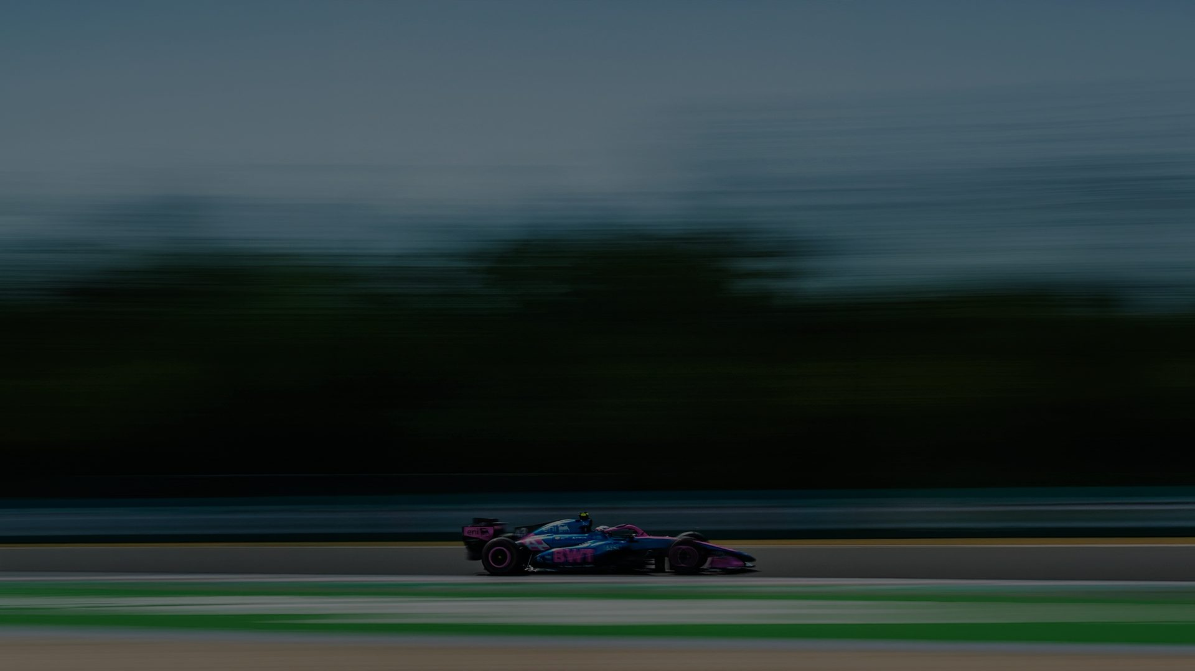
An F1 partnership can build Adyen's global brand and deepen client relationships through payments storytelling and a global hospitality programme
OUR PARTNERSHIP HYPOTHESIS
Notes:
The one sentence the rest of the deck tests: section 1 (why F1), 2 (the business network), 3 (competition), 4 (proof), then the routes and our recommendation.

Slide 4
F1 gives Adyen a global, enterprise-grade stage, and payments is now one of its most contested categories
EXECUTIVE SUMMARY
625M
A platform in growth
F1 followers in 2026, up 30.8% since 2022. New sponsorship deal value is up 165% since 2020.
THREE ROUTES INTO F1
ROUTE 1 · DRIVER Max Verstappen
Adyen powers the Verstappen ecosystem; Verstappen Travel ticketing is the most direct fit. 2027–2030.
#1
The audience Adyen sells to
F1 ranks #1 of five major sports on all five Adyen audiences, from senior decision-makers to early tech adopters.
ROUTE 2 · TEAM Alpine F1 Team
Exclusive Financial Technology Platform Partner; Adyen powers the Team's new ecommerce. £10.0M in 2027.
457M
Where Adyen does business
F1 fans across Adyen's 22 office markets, 13 of which host a 2027 race.
ROUTE 3 · TEAM Scuderia Ferrari
[ADD] Proposal to follow
4
A contested category
Stripe, Airwallex, Mastercard and Visa already partner F1 teams. Adyen is not yet in F1.
DECISION NEEDED
[ADD] The approval you are asking the Chairman for
Source: GWI; GlobalData; F1; Adyen; Kantar; rights-holder proposals; SPORTFIVE analysis. See Sources and notes.
Notes:
Left: why F1 in four proof points. Right: the three routes in front of the chairman. Alpine and Max are filled from their proposals; Ferrari's proposal is still to come.

Slide 5
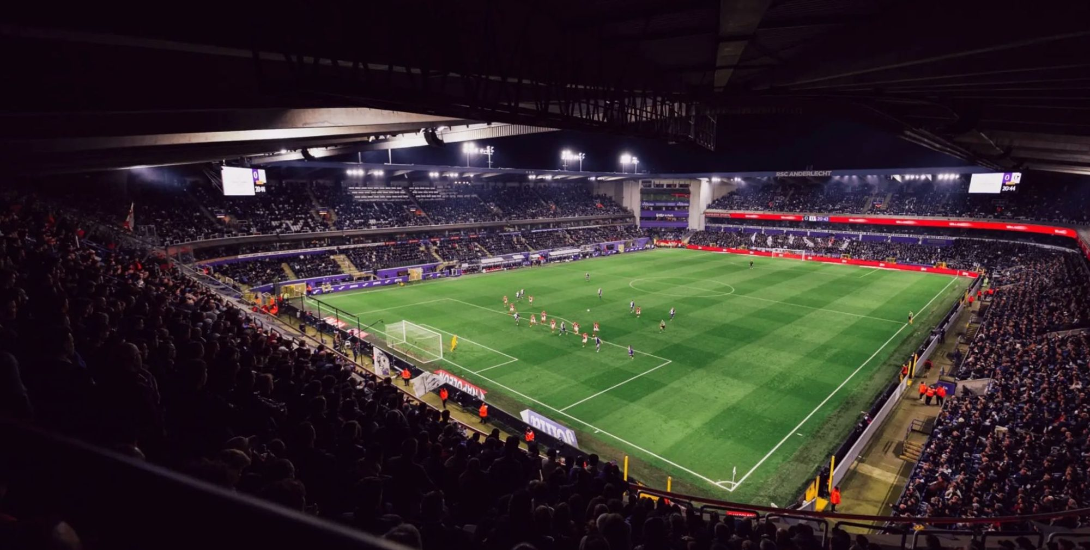
Why Formula 1
01
Growth, audience, footprint and brand value: what the data says about F1 as a platform for Adyen
01
Why F1
02
Business network
03
Competition
04
Proof
05
Routes
06
Recommendation
Notes:
Section 1 answers 'why F1 at all?' before any asset is discussed.

Slide 6
F1 is growing in audience and in commercial value
01 WHY FORMULA 1 · GROWTH
GLOBAL F1 AUDIENCE
NEW F1 SPONSORSHIP DEAL VALUE
+30.8%
2022–2026 · 147.3M additional followers
+165.3%
2020–2025 · new deals only, excludes renewals
625.3M followers in 2026, +8.3% vs 2025
125 new deals in 2025 (+28.9% vs 2020)
So what brands are paying more to be in F1. The average annual value of a new deal rose from $2.21M in 2020 to $5.78M in 2025.
Source: GWI (global audience, followers); GlobalData (new sponsorship deals only, excl. renewals). 2026 YTD: $1.91B across 139 deals, year incomplete.
Notes:
Audience: 478.0M (2022) to 625.3M (2026), +30.8%, +147.3M followers; +8.3% vs 2025.
Sponsorship: total value of NEW deals, not annual sponsorship revenue. $0.89B (2020) to $2.37B (2025), +165.3%. 125 new deals in 2025 (+28.9% vs 2020). Average annual value $2.21M to $5.78M (+161.5%). 2020-2025 used because 2026 is incomplete.

Slide 7
F1 is the strongest sport for every audience Adyen sells to
01 WHY FORMULA 1 · AUDIENCE
Sport | High income | Owners / founders | Senior decision-makers | Large-company employees | Early tech adopters
Means for Adyen | Premium consumers | Merchant owners | Enterprise buyers | Enterprise accounts | New-payment adopters
Formula 1 | 132.4 | 146.9 | 166.6 | 142.8 | 237.9
Tennis | 129.5 | 128.4 | 148.1 | 141.8 | 176.3
Cycling | 113.1 | 124.7 | 139.1 | 120.4 | 181.8
Basketball | 117.9 | 117.4 | 131.1 | 120.3 | 151.1
Football | 108.5 | 117.0 | 121.2 | 111.9 | 131.2
237.9
Early tech adopters
31% above the next-best sport (cycling, 181.8)
166.6
Senior decision-makers
12% above the next-best sport (tennis, 148.1)
F1 ranks #1 on all five measures. Higher index = stronger over-representation among the sport's fans.
So what F1 is the only sport of the five that leads on every audience Adyen needs, from enterprise buyers to the consumers adopting new ways to pay.
Source: GWI. Affinity index; ranking covers the five sports assessed. Benchmark per GWI methodology.
Notes:
Indices are not percentages. Definitions: high income = highest income segment; owners/founders = own or founded a business; senior decision-makers = influence over workplace purchasing; large company employees = companies with 1,001-5,000 employees; early tech adopters = among the first to adopt new technologies.
Next-best sport: tennis on four measures, cycling on early tech adopters.

Slide 8
F1 races where Adyen already does business
01 WHY FORMULA 1 · FOOTPRINT
REGION
ADYEN OFFICES
F1 RACES 2027
OFFICE CITY WITH A RACE
24
Europe
12
10
Madrid
North America
5
5
Mexico City
Grands Prix on the 2027 calendar
East Asia
3
2
Shanghai
28
Southeast Asia
2
1
Singapore
South America
2
1
São Paulo
Adyen offices worldwide
India
2
0
No race
7 of 8
Middle East
1
4
—
Australia
1
1
—
regions where Adyen has an office host a race
Adyen office
F1 race weekend
Source: F1 2027 calendar and Adyen office list as supplied to SPORTFIVE (calendar not independently confirmed).
Notes:
Europe: offices Amsterdam, Berlin, Brussels, London, Manchester, Madrid, Milan, Munich, Paris, Prague, Stockholm, Warsaw; races Portimão, Silverstone, Monaco, Spa-Francorchamps, Spielberg, Budapest, Monza, Madrid, Baku, Istanbul.
North America: offices San Francisco, Chicago, New York, Toronto, Mexico City; races Las Vegas, Austin, Miami, Montreal, Mexico City.
East Asia: offices Shanghai, Hong Kong, Tokyo; races Shanghai, Suzuka.
Southeast Asia: offices Kuala Lumpur, Singapore; races Singapore.
South America: offices São José dos Campos, São Paulo; races São Paulo.
India: offices Mumbai, Bengaluru; races none.
Middle East: offices Dubai; races Sakhir, Jeddah, Lusail, Abu Dhabi.
Australia: offices Sydney; races Melbourne.

Slide 9
457M F1 fans live in Adyen's markets, and India and Japan are accelerating
01 WHY FORMULA 1 · PRIORITY MARKETS
Hosts a 2027 race
No race in 2027
F1 audience, millions (growth 2022–2026)
457.2M
F1 fans across Adyen's 22 office markets
+33.6% since 2022; 13 of the 22 markets host a 2027 race.
India · 117.4M
PRIORITY MARKET
+94.9% since 2022
The fastest growth of any Adyen office market, with no Grand Prix on the calendar.
Japan · 7.1M
PRIORITY MARKET
+41.2% since 2022
A priority market for Adyen, home of the Suzuka Grand Prix.
Plus 11 further Adyen markets: 34.4M fans.
Source: GWI (F1 audience by market, 2026 vs 2022); Adyen (office markets). Growth rates as reported.
Notes:
All 22 Adyen office markets: combined F1 audience 457.2M in 2026 vs 342.3M in 2022 (+33.6%). 13 of 22 host a 2027 race (59%). Chart shows the 11 largest; the other 11 (Malaysia, Canada, Australia, Poland, Netherlands, UAE, Belgium, Czechia, Sweden, Singapore, Hong Kong) add 34.4M. Fastest growth: India +94.9%, Australia +85.2%, US +74.3%, Canada +62.1%.

Slide 10




The world's most valuable brands already invest in F1
01 WHY FORMULA 1 · BRAND COMPANY
Brand involved in F1 (SPORTFIVE analysis)
Enterprise tech sells through F1
Google, Microsoft, Amazon, Oracle, IBM and Dell all use F1 to reach enterprise buyers.
Payments is already on the grid
Visa, Mastercard, American Express and Stripe sit in the Top 100 and in F1.
The room Adyen wants to be in
F1 puts Adyen alongside the brands that set the benchmark for brand value.
So what F1 is where the world's most valuable brands build theirs.
Source: Kantar BrandZ 2026 Most Valuable Global Brands (incl. data from S&P Capital IQ and Euromonitor). F1 involvement marked by SPORTFIVE.
Notes:
Kantar BrandZ 2026 Top 100. Boxes mark the brands the SPORTFIVE team identified as involved in F1 (40 of the 100 as marked). Check the marked set before quoting a count in the room.

Slide 11
Strong brands outperform the market, and F1 partners are growing theirs
01 WHY FORMULA 1 · BRAND VALUE
PORTFOLIO PERFORMANCE INDEX (2019 = 100)
TOTAL RETURN, 2006–2026
IBM
504%
$150.8B
Kantar Strong Brands Portfolio
2026 brand value, +20% vs 2025
Ferrari partner
451%
S&P 500
American Express
$80.3B
234%
Brands with the strongest future power returned 2.3x the STOXX Europe 600.
2026 brand value, +22% vs 2025; doubled since 2024
Official F1 partner
MSCI World Index
So what IBM and American Express both posted their biggest brand-value gains in the year they entered F1 partnerships.
Source: Kantar × Google 2026 (European companies); Kantar BrandZ 2026 (Strong Brands Portfolio 2006–2026; IBM and American Express brand spotlights).
Notes:
Different, meaningful, salient: Kantar's drivers of brand equity. The IBM and American Express point is the team's analysis of Kantar BrandZ data: both posted their biggest brand-value increase in the year they entered F1 partnerships. Confirm before quoting.

Slide 12



Why F1 makes sense for Adyen, in six data points
01 WHY FORMULA 1 · WHAT IT MEANS FOR ADYEN
Reach enterprise buyers
Lead on innovation
Grow in priority markets
166.6
237.9
457M
Senior decision-maker index, the highest of the five sports assessed
Early tech adopter index, 31% above the next-best sport
F1 fans across Adyen's 22 office markets, +33.6% since 2022
Host clients where they are
Keep pace with the category
Invest in a rising asset
13 of 22
4
$5.78M
Adyen office markets host a Grand Prix in 2027
Payment brands already in F1: Stripe, Airwallex, Mastercard, Visa
Average annual value of a new F1 deal in 2025, up from $2.21M in 2020
Source: GWI; GlobalData; F1; Adyen; SPORTFIVE analysis.
Notes:
This is the synthesis of section 1. Each card pairs something Adyen needs from a partnership with the evidence that F1 delivers it.

Slide 13
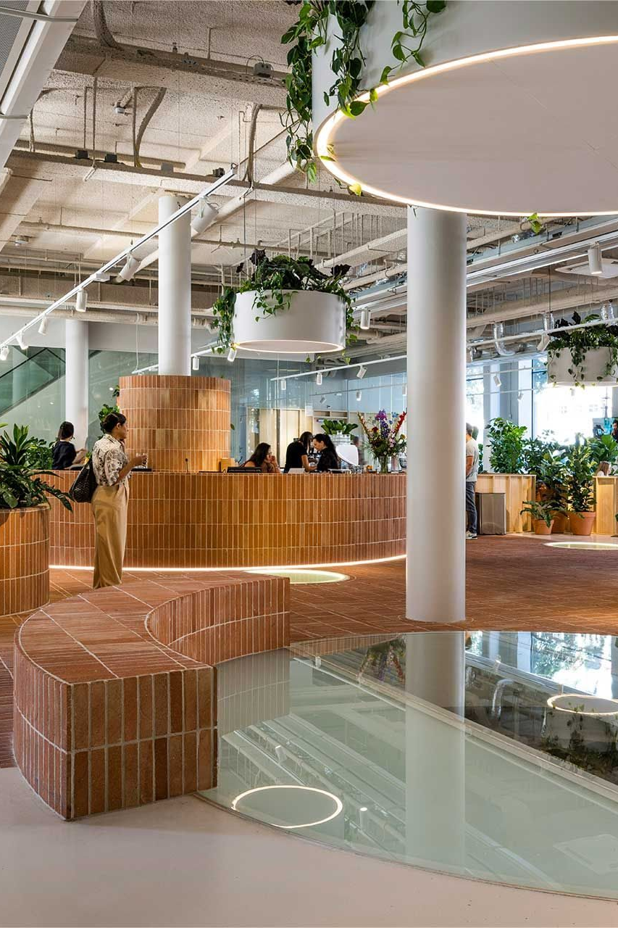
F1 as a business network
02
Who Adyen would sit alongside: each team's partner network by size, sector and audience
01
Why F1
02
Business network
03
Competition
04
Proof
05
Routes
06
Recommendation
Notes:
Section 2 is the partnership-selection lens from the team deck: networks and audience.

Slide 14
Mercedes, McLaren and Ferrari bring the largest partner networks
02 BUSINESS NETWORK · PARTNER REVENUE
PARTNERS' TOTAL COMBINED REVENUE ($ BILLION)
Team | Top 3 partners by reported annual revenue
Mercedes-AMG | Microsoft, Meta, PepsiCo
McLaren | Dell, Deloitte, Cisco
Ferrari | Shell, IBM, HP
Aston Martin | Aramco, TikTok, Cognizant
Red Bull Racing | AT&T, Siemens, Oracle
Alpine | Eni, Boeing, Claro
Racing Bulls | Siemens, Randstad, Cash App
Williams | Barclays, Komatsu, BNY
Cadillac | Claro, Tenneco, Tommy Hilfiger
Audi | Adidas, Visit Qatar, Hyatt Hotels
Haas | MGM Resorts, CommScope, UChicago Medicine
Source: SPORTFIVE analysis. 2024–2025 public data; estimates where no disclosure; some revenues from parent-company segments. USD at 2024–25 average FX (Bloomberg/ECB).
Notes:
Partners' total combined revenue by team, and each team's three largest partners by reported annual revenue. Team note: figures being re-checked (GF). Alpine and Ferrari are highlighted as the two team routes.

Slide 15
McLaren and Mercedes lead on blue-chip partners; Alpine's 42 partners are mostly private
02 BUSINESS NETWORK · PARTNER PROFILE
Tier 1 Mega-cap · $200B+
Tier 2 Large-cap · $50–200B
Tier 3 Mid-cap · $5–50B
Tier 4 Small-cap · below $5B
 | Mercedes | McLaren | Ferrari | Aston Martin | Red Bull | Alpine | Racing Bulls | Williams | Cadillac | Haas
Partners (total) | 28 | 54 | 40 | 34 | 32 | 42 | 24 | 27 | 10 | 22
Public / private | 72 / 28% | 58 / 42% | 50 / 50% | 32 / 68% | 38 / 62% | 26 / 74% | 33 / 67% | 33 / 67% | 50 / 50% | 18 / 78%
Tier 1 · mega-cap | 5 | 6 | 3 | 3 | 3 | 1 | 2 | 2 | – | –
Tier 2 · large-cap | 9 | 10 | 5 | 2 | 2 | 3 | 1 | 3 | 1 | –
Tier 3 · mid-cap | 6 | 19 | 9 | 12 | 10 | 7 | 9 | 9 | 7 | 4
Tier 4 · small-cap | 3 | 18 | 22 | 16 | 17 | 31 | 10 | 13 | 2 | 17
So what McLaren (6) and Mercedes (5) have the most mega-cap partners; 31 of Alpine's 42 partners are small-cap and 74% are private.
Source: SPORTFIVE analysis. Public data; estimates where no disclosure. USD at 2024–25 average FX (Bloomberg/ECB). Audi not included.
Notes:
Market-cap tiers: Tier 1 mega-cap $200B+; Tier 2 large-cap $50–200B; Tier 3 mid-cap $5–50B; Tier 4 small-cap below $5B. Team note: figures being re-checked (GF). Haas public/private split as supplied (18/78) does not sum to 100: check.

Slide 16
Financial services already sits in every team's partner network
02 BUSINESS NETWORK · SECTOR MAPPING
So what every team counts financial-services partners, from 1 (Cadillac) to 6 (McLaren, Williams). Alpine has 4, Ferrari 5.
Source: SPORTFIVE partner mapping. Relevant team partners only, by sector.
Notes:
Number of relevant team partners by sector. FS&I = financial services and insurance; IT&I = IT and internet. Team note: figures being re-checked (GF).

Slide 17
Every team's fans over-index on working in financial services
02 BUSINESS NETWORK · FANS IN FINANCE
INDEX VS GENERAL POPULATION (= 100) · FANS IN FINANCIAL SERVICES
172.9
Mercedes fans
The highest index of any team
1.80M
Ferrari fans
The largest pool working in financial services
140.1
Alpine fans
0.26M fans in financial services
Source: Global Web Index (2026). Index vs general population (= 100). North America and Europe (excl. Russia). Average of 11 teams.
Notes:
Index and size of each team's fanbase working in the financial sector. Highest index: Mercedes (172.9). Largest pool: Ferrari (1.80M). Alpine: 140.1, 0.26M.

Slide 18

Competitive landscape
03
Who is already using sport, and F1 in particular, to win in payments
01
Why F1
02
Business network
03
Competition
04
Proof
05
Routes
06
Recommendation
Notes:
Section 3 shows the category is moving: competitors are in, and the benchmark has shifted from logos to integration.

Slide 19




Payments is one of F1's most contested categories
03 COMPETITIVE LANDSCAPE · PAYMENTS IN F1
Four payment brands already partner F1 teams
Two are Adyen competitors (Stripe, Airwallex); two are card schemes (Mastercard, Visa).
COMPETITOR
COMPETITOR
Stripe
Airwallex
Mercedes-AMG Petronas F1 Team
McLaren F1 Team
Integration is the new benchmark
Airwallex sits inside McLaren's business, not just on the car.
ADYEN PARTNER
ADYEN PARTNER
Mastercard
Visa
Card schemes are partners, not blockers
Visa and Mastercard partner Adyen; Mastercard and Airwallex already co-exist at McLaren.
McLaren Mastercard F1 Team
Red Bull
Not yet in F1. Three routes are on the table: Max Verstappen, Alpine and Ferrari.
Source: SPORTFIVE analysis. Team names as used in the BI scan.
Notes:
Stripe and Airwallex compete with Adyen directly. Visa and Mastercard are card schemes and Adyen partners; Mastercard and Airwallex already sit side by side at McLaren, which shows scheme and platform partners can co-exist.

Slide 20
Adyen's competitors are already buying into sport, but only two have committed to F1
03 COMPETITIVE LANDSCAPE · COMPETITORS IN SPORT
Competitor | F1 (2) | Football (11) | US leagues & college (12) | Other & venues (7)
Stripe | Mercedes-AMG Petronas F1 Team | — | — | Ryder Cup
Airwallex | McLaren F1 Team | Arsenal FC | San Francisco Giants | Essendon FC
PayPal | — | Liverpool FC, San Jose Earthquakes | Seattle Seahawks, NFL, Big 12 Conference | —
Fiserv | — | — | — | Clover Park, Fiserv Forum
Shift4 | — | Austin FC, Charlotte FC, Chicago Fire FC, LAFC, San Diego FC, Sporting KC | Kansas City Chiefs, Las Vegas Raiders, New Orleans Saints, Chicago Cubs, Texas Rangers | —
Global Payments | — | — | Minnesota Twins, Philadelphia 76ers | Mercedes-Benz Stadium
Ant International | — | Argentinian Football Association, Tottenham Hotspur FC | NBA China Games | Carlos Alcaraz, Laver Cup
So what competitor money is spread across football and US leagues. In F1, only Stripe and Airwallex have team partnerships: the category is still open for Adyen to lead.
Source: SPORTFIVE BI competitor scan (not exhaustive). Property types vary (teams, leagues, venues, athletes); no equivalence of rights, fees or exclusivity implied.
Notes:
Counts by column: F1 2, football 11, US leagues & college 12, other sport & venues 7 (32 properties in total). Football includes MLS clubs. 'Other' covers golf, tennis, Australian football and venues.

Slide 21

The model to beat: Airwallex × McLaren, integration not a logo
03 COMPETITIVE LANDSCAPE · THE BENCHMARK
WHAT AIRWALLEX DID
1
Positioned the deal as business integration, embedding its financial solutions in the partner's operations.
2
Activated the IP across content, events, hospitality and performance marketing.
3
Built one B2B sports platform: McLaren in F1, plus Arsenal FC, San Francisco Giants and Essendon FC.
Reported results live in 14 days; 90% of McLaren's payments arrive within hours, 65% instantly; local payment networks in 110+ countries.
WHAT IT MEANS FOR ADYEN
Lead with where Adyen sits inside the partner's business, not the logo.
Show a clear line to revenue and payment volume.
Put hospitality at the centre, connecting people across the partner's ecosystem.
Source: SPORTFIVE analysis; McLaren Racing and Airwallex case study.
Notes:
The benchmark Adyen's brief sets: a payments brand inside the team's business. Section 4 shows the detail, including SPORTFIVE's role in the deal.

Slide 22

Proof and credentials
04
What F1 partners get back, and what SPORTFIVE has already delivered in payments
01
Why F1
02
Business network
03
Competition
04
Proof
05
Routes
06
Recommendation
Notes:
Section 4: proof of concept and delivery credentials.

Slide 23
F1 partners report real commercial returns from hosting at races
04 PROOF · F1 PARTNER CASE STUDIES
KOMATSU × WILLIAMS
HPE × MERCEDES
BUSINESSOLVER × ALPINE
$100M+
$300M+
$122M
orders received at races
revenue opportunity accelerated from race activations alone
business pipeline influenced by at-track hosting and experiences
Komatsu hosts key global stakeholders at races, many at a Komatsu event for the first time: a unique setting for client relationships and deal acceleration.
"For us, the real value has been the ability to authentically showcase our technology through Mercedes F1 use cases in advertising, on digital platforms, at strategic events, with press and analysts, and through direct customer engagement at races."
Technology powered by people: Businessolver uses its Alpine partnership to bring clients into F1 and showcase AI, decision-support and real-time analytics.
3,735 stakeholders hosted
An Alpine partner (Route 2)
90% found it useful for business discussions
94% guest satisfaction
Antonio Neri, CEO, Hewlett Packard Enterprise
Source: Komatsu × Williams, HPE × Mercedes and Businessolver × Alpine published case material, as compiled by SPORTFIVE.
Notes:
Three partners, three proof points: deals closed at races (Komatsu), revenue opportunity accelerated (HPE) and pipeline influenced (Businessolver, an Alpine partner).

Slide 24




This is what we've done: Airwallex × McLaren, powering performance
04 PROOF · SPORTFIVE CREDENTIALS
Showcased Airwallex's payment service solutions to a wide variety of enterprises on a global scale.
OUR SCOPE OF ADVISORY AND EXECUTION
Diagnosed the FinTech enterprise awareness gap
Mapped the F1 B2B opportunity landscape
Benchmarked fintech differentiation and positioning
Built a B2B partnership evaluation model
Modelled investment scenario trade-offs
Engineered an enterprise-focused rights portfolio
Structured the deal for network access
Enabled a board-level partnership decision
Source: SPORTFIVE. Images: McLaren Racing and Airwallex.
Notes:
SPORTFIVE's flagship F1 payments credential. We showcased Airwallex's payment solutions to enterprises worldwide through McLaren. Add: how Airwallex helped McLaren on speed (see next slide).

Slide 25
How Airwallex optimised McLaren's financial operations
04 PROOF · PROOF OF CONCEPT
BUSINESS CHALLENGE
14 days
0.5 day
McLaren Racing operates across 24 race locations, with frequent international supplier payments.
A manual process: around 30 payments per run, high FX and transfer fees, 2–5 day settlement via banks and SWIFT.
Under F1's cost cap, efficiency frees budget for on-track performance.
to implement
saved per month on payment runs
£4,000+
110+
AIRWALLEX SOLUTION
annual savings on transaction and FX fees
countries with local payment networks
Implemented in 14 days.
Automated global payment workflows: batch payouts, approvals, faster cross-border transfers.
Suppliers paid in local currencies; integrated with existing banking and accounting for cash-flow visibility.
90% of payments arrive within hours, 65% instantly
So what lower payment costs, no manual runs and faster cash movement: efficiencies McLaren reinvests in racing performance.
Source: McLaren Racing modernises cross-border payments with Airwallex (Airwallex case study), as compiled by SPORTFIVE.
Notes:
McLaren Racing modernises cross-border payments with Airwallex. The point for Adyen: a payments partner that solves a real operational problem for the team earns the case study.

Slide 26

The opportunities
05
Three routes into F1: Max Verstappen, Alpine F1 Team and Scuderia Ferrari
01
Why F1
02
Business network
03
Competition
04
Proof
05
Routes
06
Recommendation
Notes:
Section 5. Each route uses the same three slides (overview, business opportunity, rights) so the chairman can compare like for like. Ferrari's proposal is still to come.

Slide 27

Three routes into F1 for Adyen
05 THE OPPORTUNITIES · OVERVIEW
[ADD] Photo of Max Verstappen
[ADD] Image or logo
ROUTE 1 · DRIVER
ROUTE 2 · TEAM
ROUTE 3 · TEAM
Max Verstappen
Alpine F1 Team
Scuderia Ferrari
The opportunity
Official ambassador; Adyen powers the Verstappen business ecosystem
The opportunity
Exclusive Financial Technology Platform Partner, global
The opportunity
[ADD] proposal to follow
Where Adyen sits
Verstappen Travel ticketing and trailers; Pro Simulation booking
Where Adyen sits
Powers the Team's new ecommerce platform, then hospitality and network
Where Adyen sits
[ADD] proposal to follow
Investment
[ADD] fee
Investment
£10.0M in 2027, +5% a year (£31.5M over 3 years)
Investment
[ADD] proposal to follow
Term and status
2027–2030, non-exclusive; for discussion
Term and status
2027–2029; provisional, subject to contract
Term and status
[ADD] proposal to follow
Source: Max Verstappen × Adyen rights package (for discussion); Alpine F1 Team Provisional Rights Overview 2027–2029; Ferrari to follow.
Notes:
One line per field. Detail slides follow in the same order. Max's fee and Ferrari's proposal still to add.

Slide 28
Two Dutch innovators: Adyen powers the Verstappen ecosystem
05 THE OPPORTUNITIES · ROUTE 1 · MAX VERSTAPPEN
Max Verstappen has built one of the most successful personal brands in global sport; Adyen has built one of the world's leading financial technology platforms. Together they can create a living case study of how high-performance businesses are built, operated and scaled. Max is an athlete entrepreneur with businesses beyond F1, so Adyen becomes the technology platform behind the Verstappen ecosystem, powering customer journeys across racing, travel, merchandise and experiences. The commercial integration creates genuine proof of performance; the marketing rights tell that story to customers, prospects and partners worldwide.
SOCIAL REACH
19.3M
3M
1M
Instagram followers
Facebook
YouTube
TOP MARKETS BY FOLLOWERS
USA
Brazil
Netherlands
Mexico
UK
Germany
Source: Max Verstappen × Adyen rights package (for discussion); followers as supplied.
Notes:
Adyen powers Max Verstappen. Add a photo of Max in the picture placeholder on the left. Follower counts as supplied in the team deck; check before the meeting.

Slide 29
Max is a business ecosystem: Verstappen Travel is the most direct fit for Adyen
05 THE OPPORTUNITIES · ROUTE 1 · BUSINESS OPPORTUNITY
Max's business | Adyen products | What it does | Can Adyen run it?
Verstappen.com online store | Online Payments, Payment Methods | Merchandise | No, not without Fanatics. Fanatics runs the store under an exclusive deal and controls checkout.
Verstappen Travel: Orange Army grandstands (Austria, Spa, Hungary) | Online Booking, Online Payments | Ticket sales | Yes, the most direct fit. Needs Verstappen.com's ticketing provider to connect to Adyen.
Verstappen Travel: trailers (Austria, Spa, Hungary) | Tap to Pay | Trackside merchandise | Yes, the most direct fit. Needs Verstappen.com's payment provider to connect to Adyen.
Verstappen Racing (GT3) | [ADD] | Potential trackside merchandise | Possible.
Verstappen Racing (esports) | [ADD] | Weekly Twitch streams; competition races | Possible: "Powered by Adyen".
Verstappen Racing Pro Simulation (driver development) | [ADD] | AI subscription-based driver development programme, in the works | Possible. No payments today, so a new build.
Verstappen News | [ADD] | Database | Possible. No payments today, so a new build.
Verstappen official app (free: news, stats, alerts, shop link) | [ADD] | Adds one-tap purchase of merchandise, grandstand tickets and experiences | Possible. The app has no payments today, so a new build.
Source: SPORTFIVE assessment of the Verstappen business ecosystem.
Notes:
Powering a high-performance ecosystem. Blank Adyen-product cells are still to define with Adyen. The online store is out of reach while Fanatics holds the exclusive deal.

Slide 30
Rights package: Max Verstappen × Adyen
05 THE OPPORTUNITIES · ROUTE 1 · RIGHTS PACKAGE
A strong opportunity to support Adyen's entry into motorsport with four-time World Champion Max Verstappen and his personal racing pillars: GT3, Rally and Sim Racing. For discussion purposes.
DURATION: 2027–2030 (3 YEARS)
AMBASSADOR ROLE
Max Verstappen as official ambassador
1 full day (6 hours) of driver time in a personal capacity, e.g. ad campaign, social content, press interviews
3 × 15-minute paddock meet-and-greets with Max, each for 3 VIP guests
Rights: non-exclusive. IP rights of Max in his personal and Verstappen Racing capacity only: digital and online, TV ad, print, out of home
HOSPITALITY
Formula 1 garage tour for 2 VIP guests
Private track day for stakeholders
SPORTFIVE addition: Paddock Club hospitality at selected Adyen races throughout the season (to confirm)
ADYEN BUSINESS INTEGRATION
Verstappen Travel B2C: official Orange Army grandstand ticketing for the Spa and Austria GPs 2027 (to discuss); branding on trailers and Orange Army goodie bags; joint B2C ticketing partnership in GTWC, e.g. 24 Hours of Spa (to discuss)
Verstappen Pro Simulation: booking payment system
BRANDING: GT3, RALLY AND SIM RACING
Helmets: Max's private Verstappen Racing helmet (chin); helmets of all Verstappen Racing drivers (chin)
Car and garage: Verstappen Racing Mercedes GT3 2027 car (position to discuss, not full car); garage branding (to discuss)
Race wear: race suit and underwear top (front chest and sleeves); cool vest (front chest); gloves
Team wear: multiple items (front chest)
CONTENT
Max Verstappen and Verstappen.com social channels (to discuss)
Source: Max Verstappen × Adyen rights package, for discussion purposes. Not a contract.
Notes:
Transcribed from the rights package in the team deck. The GT3 car position reads 'to discuss (not full car)'. Paddock Club hospitality is a SPORTFIVE addition: Max's own package excludes Red Bull assets and hospitality, so confirm how it is delivered.

Slide 31
Alpine: Performance in Every Transaction, from checkout to chequered flag
05 THE OPPORTUNITIES · ROUTE 2 · ALPINE F1 TEAM
Every F1 result depends on thousands of complex processes working together with speed, precision and resilience; Adyen does the same for enterprise commerce. As the Team's exclusive Financial Technology Platform Partner, Adyen powers Alpine's new ecommerce platform, making every fan purchase a live proof point. Content, race-week experiences and C-level hospitality then turn that proof into senior customer conversations, and the Team's partner network opens doors to new business.
ALPINE FANS VS. THE AVERAGE INTERNET USER
10.0M 2.22x
23.6M 1.88x
5.6M 1.98x
Alpine mock-up: Adyen on the engine cover
senior decision-makers
business decision-makers
company owners, founders
Exclusive
Financial Technology Platform Partner
2027–2029
three years, global rights
4.5M 3.02x
24.3M 1.83x
7.2M 1.59x
£10.0M
fee in 2027, +5% a year
56
Paddock Club tickets a year
technology early adopters
Google Pay users
Apple Pay users
Source: Alpine Formula One Team, Provisional Rights Overview 2027–2029 (not legally binding). Audience: GWI Core, Q3 2025–Q2 2026, all internet users.
Notes:
Alpine's objectives for Adyen: (1) prove the enterprise platform through a measurable ecommerce integration and a client-facing case study; (2) deepen relationships with priority customers through C-level hospitality and F1 experiences; (3) generate qualified new business through the Team's international partner network. Apple Pay audience data covers selected markets only. Car image is Alpine's mock-up of Adyen branding.

Slide 32
Alpine: Adyen powers the Team's commerce, then turns that proof into relationships
05 THE OPPORTUNITIES · ROUTE 2 · BUSINESS OPPORTUNITY
1 Integrate
Power the experience
2 Prove
Prove the performance
3 Experience
Bring it to life
4 Convert
Accelerate relationships
Alpine's business | Activation | What Adyen does | Outcome for Adyen
Team ecommerce store (new platform) | The Integrated Commerce Garage | Powers agreed parts of the Team's ecommerce environment: a dependable, locally relevant purchase journey for fans | Measurable proof: checkout completion, payment performance, efficiency, customer experience
Fan rewards | Checkout to Chequered Flag Rewards | Eligible online purchases unlock selected Team rewards, merchandise or experiences | Engagement, conversion and repeat purchase
Content and storytelling | The Performance Proof Series | Documentary films, technical features and executive interviews on the integration, plus short-form assets | Flagship case study and sales enablement
Enstone factory (UK) | Commerce Under Pressure Live Lab | Immersive session for customers and prospects: commerce scenarios, Team insights, expert discussion | Credibility with customers and prospects
Grand Prix host city, with an Adyen customer | Race Week, One Platform | A flagship venue becomes a race-week experience: booking, mobile ordering, venue payments, merchandise | Live product demo and a three-party case study
Grand Prix hospitality | Adyen Commerce Club | C-level programme at selected Grands Prix: hospitality, private discussions, garage tours, Team appearances | Stronger relationships with priority accounts
Team partner network | One Platform Partner Forum | Recurring forum connecting Team partners with Adyen experts, customers and enterprise leaders | Qualified introductions and new business
Source: Alpine Formula One Team, Provisional Rights Overview 2027–2029: marketing framework and appendix.
Notes:
Four pillars: Power the experience (rows 1-2), Prove the performance (rows 3-4), Bring it to life (row 5), Accelerate relationships (rows 6-7). The Partner Forum facilitates introductions without guaranteeing procurement outcomes. Rewards are subject to promotional and regulatory controls.

Slide 33
Rights overview: Alpine F1 Team × Adyen
05 THE OPPORTUNITIES · ROUTE 2 · RIGHTS OVERVIEW
COMMERCIAL TERMS
Category: Financial Technology Platform
Designation: Financial Technology Platform Partner (exclusive); Premium Partner (non-exclusive)
Term and territory: 2027–2029, global
Fee: £10.0M (2027), £10.5M (2028), £11.025M (2029); 5% annual escalator
Payment: 40% on signing (by 15 Feb in later years), 30% by 15 Sep, 30% by 15 Dec
Championship bonus: 25% / 12.5% / 6.5% for 1st / 2nd / 3rd; maximum 150%
Contracting entity: Alpine Racing Ltd.
BRANDING (ALL SEASON)
Race car: engine cover (middle lower); halo top back (one side)
Showcar and virtual car: all showcars; the official F1 game (EA)
Kit: driver suit and mechanics suit collar*; driver and mechanics helmet chin; team kit collar, one side*
Partner stack: HQ, transporters, motorhome, hospitality, media backdrop, garage, website
*Race kit as soon as feasible in 2027; team kit on polos in 2027, full collection from 2028.
IP RIGHTS
Team property, imagery and footage on marketing materials, subject to approval
APPEARANCES (PER YEAR)
F1 drivers: 3 × 1-hour race-weekend off-track; 2 × 4-hour marketing
Reserve driver: 2 × 1-hour race-weekend; 1 × 4-hour marketing
Senior team member: 2 × 1-hour race-weekend; 2 × 4-hour marketing; 1 × 6-hour conference
INTEGRATION AND CONTENT
Product integration and in-market activation
Partner content capture day; 2 social media campaigns; case studies
4 newsletter content blocks; 2 solus CRM emails
LAUNCH AND SERVICING
Joint launch with press release and social post; dedicated account manager; media reporting (Nielsen, Blinkfire)
HOSPITALITY (PER YEAR)
Paddock Club: 56 tickets: 24 at selected races, 16 at Monaco, Singapore, Austin or Abu Dhabi, 8 at Miami, 8 at Las Vegas; more at partner rate
Also: grandstand tickets at partner rate; one-day paddock passes on request; 2 U.S. near-track dinners (15 guests)
OFF-TRACK EXPERIENCES
Enstone: 2 VIP factory tours (12 guests) and 1 factory event (60 guests), at Alpine's cost
Assets: showcar and Trak Racer simulators, 14 days' hire each at Adyen's cost
Driving: 1 motorsport driving day for 24 guests at Alpine's cost; more to buy, e.g. Lapland Ice Driving
Network: introductions to Alpine's partners; 6 car-launch tickets
MERCHANDISE
Polos and caps: 40 signed and 80 unsigned of each; 2 replica helmets, 50 mini helmets, 2 replica driver sets
Source: Alpine Formula One Team, Provisional Rights Overview 2027–2029. All rights subject to change; not legally binding.
Notes:
All benefits are per year of the term unless stated. Paddock Club: 24 tickets at selected races excluding Monaco, Singapore, Austin, Miami, Las Vegas and Abu Dhabi; 16 at Monaco, Singapore, Austin or Abu Dhabi; 8 at Miami; 8 at Las Vegas (56 in total). Championship bonus: 25% (1st), 12.5% (2nd), 6.5% (3rd); maximum 150% should both Drivers' and Constructors' bonuses be achieved.

Slide 34
Scuderia Ferrari: [ADD: one-line positioning]
05 THE OPPORTUNITIES · ROUTE 3 · SCUDERIA FERRARI
[ADD] Narrative: why Ferrari, and what Adyen would power
HEADLINE NUMBERS
[ADD]
[ADD]
[ADD]
[ADD] number and label
[ADD] number and label
[ADD] number and label
KEY FACTS
[ADD] Designation · term · territory · fee
Source: [ADD: Ferrari proposal]
Notes:
Ferrari overview. Left blank until Ferrari's proposal arrives. Mirror the Max and Alpine overviews: positioning, a short narrative, headline numbers and key facts.

Slide 35
Ferrari: [ADD: where Adyen sits in Ferrari's business]
05 THE OPPORTUNITIES · ROUTE 3 · BUSINESS OPPORTUNITY
Ferrari's business | Adyen products | What it does | Can Adyen run it?
[ADD] | [ADD] | [ADD] | [ADD]
[ADD] | [ADD] | [ADD] | [ADD]
[ADD] | [ADD] | [ADD] | [ADD]
[ADD] | [ADD] | [ADD] | [ADD]
[ADD] | [ADD] | [ADD] | [ADD]
Source: [ADD]
Notes:
Ferrari business opportunity. Same columns as Max and Alpine so the routes compare like for like.

Slide 36
Rights package: Scuderia Ferrari × Adyen
05 THE OPPORTUNITIES · ROUTE 3 · RIGHTS PACKAGE
COMMERCIAL TERMS
BRANDING AND IP
HOSPITALITY AND EXPERIENCES
[ADD] Category, designation, term, fee, payment schedule
[ADD] Car, kit, team environment; IP rights
[ADD] Paddock Club, factory, driving, merchandise
Source: [ADD: Ferrari proposal]
Notes:
Ferrari rights package. Use the same three columns as the Alpine and Max rights slides.

Slide 37
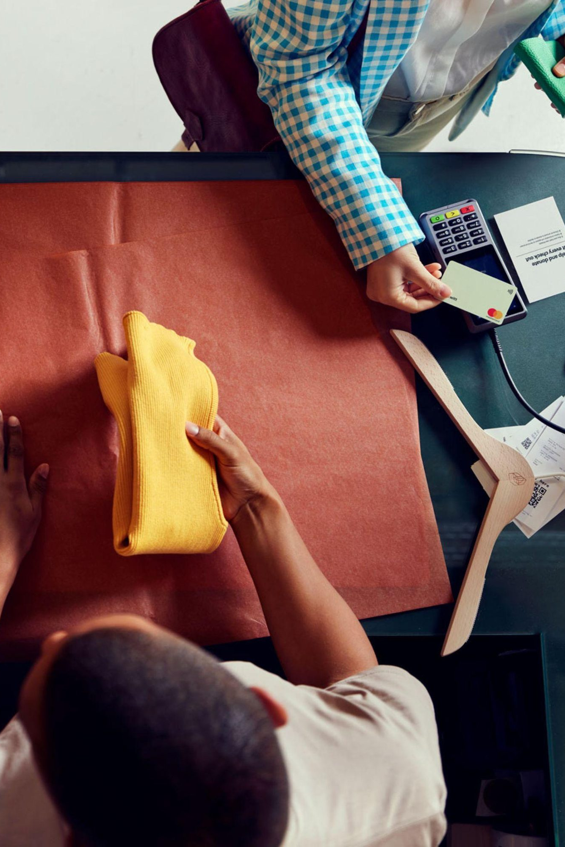
Our recommendation
06
The preferred route, how Adyen integrates, the value and the investment
01
Why F1
02
Business network
03
Competition
04
Proof
05
Routes
06
Recommendation
Notes:
Section 6 closes the case: which route, why, where Adyen sits in the business, what it costs and what happens next.

Slide 38
Why we recommend [ADD: route]
06 RECOMMENDATION · ASSESSMENT
Criterion | Max Verstappen | Alpine F1 Team | Scuderia Ferrari
Integration inside the partner's business | [ ● ◐ ○ ] Verstappen Travel ticketing and trailers fit directly; the online store is held by Fanatics; app and sim are new builds | [ ● ◐ ○ ] Powers agreed parts of the Team's new ecommerce platform | [ADD ● ◐ ○ + evidence]
Clear line to revenue and payment volume | [ ● ◐ ○ ] Grandstand ticketing (Spa, Austria 2027) and trackside merchandise | [ ● ◐ ○ ] Checkout, rewards and race-week venue payments; KPIs proposed | [ADD ● ◐ ○ + evidence]
Hospitality at the centre | [ ● ◐ ○ ] Garage tour, track day and paddock meet-and-greets; Paddock Club to be added | [ ● ◐ ○ ] 56 Paddock Club tickets a year, Enstone events, near-track dinners | [ADD ● ◐ ○ + evidence]
Access to the partner's commercial network | [ ● ◐ ○ ] Max's personal business ecosystem; no team partner network | [ ● ◐ ○ ] Introductions to 42 Team partners; One Platform Partner Forum | [ADD ● ◐ ○ + evidence]
Reach in Europe, North America and APAC (incl. Japan, India) | [ ● ◐ ○ ] Top follower markets: USA, Brazil, Netherlands, Mexico, UK, Germany | [ ● ◐ ○ ] Global rights; races across all of Adyen's regions | [ADD ● ◐ ○ + evidence]
Fits the investment envelope | [ ● ◐ ○ ] Fee to add | [ ● ◐ ○ ] £10.0M in 2027, rising 5% a year | [ADD ● ◐ ○ + evidence]
Payments category available | [ ● ◐ ○ ] Non-exclusive ambassador rights | [ ● ◐ ○ ] Exclusive Financial Technology Platform category | [ADD ● ◐ ○ + evidence]
Our recommendation [ADD: route], because [ADD: one-line rationale]
Source: SPORTFIVE assessment against Adyen's partnership brief; rights-holder proposals.
Notes:
Evidence in each cell comes from the proposals. Rate each route ● strong, ◐ partial, ○ weak before the meeting. Ferrari to add.

Slide 39



Where Adyen sits inside [ADD: route]'s business
06 RECOMMENDATION · BUSINESS INTEGRATION
One platform, end to end
Adyen already runs the whole payment journey for its clients: gateway, risk, authentication, processing, acquiring and reconciliation, online and in person.
1 Power
2 Prove
3 Host
4 Connect
Adyen runs the partner's payments across ticketing, ecommerce, merchandise and hospitality.
Live volumes and conversion data become a flagship, client-facing case study.
Hospitality at the centre, connecting clients across the partner's ecosystem.
Access to the partner's commercial network turns into qualified pipeline.
[ADD] Which flows Adyen powers
[ADD] KPIs to report
[ADD] Races, guests, format
[ADD] Target partners and accounts
So what integration first, not a logo deal. Every route is tested on how deeply Adyen sits inside the partner's commercial operations.
Source: Adyen ('Racing | Unified Payments': unified commerce value chain); [ADD] partner detail.
Notes:
Integration first, not a logo deal. Top: Adyen's own racing value chain, one platform from fan to business bank account. Replace each [ADD] with the flows, KPIs, races and partners agreed with the chosen rights-holder.

Slide 40


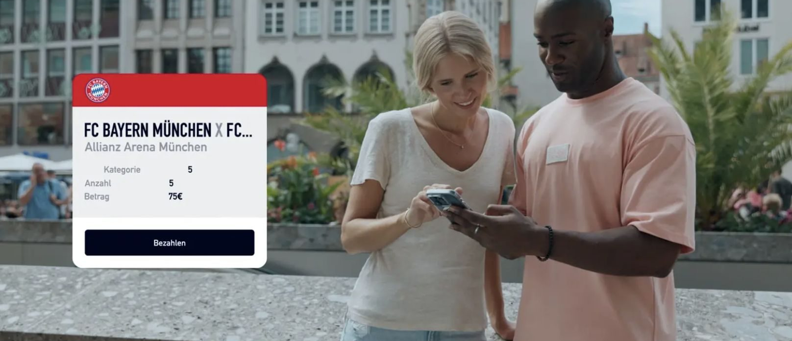

A clear line to revenue and payment volume
06 RECOMMENDATION · VALUE
HOW THE PARTNERSHIP PAYS BACK
PROOF: ADYEN ALREADY POWERS SPORT
Payment volume processed
Qualified pipeline
+36.6%
[ADD]
[ADD]
F&B revenue at RSC Anderlecht
after moving the whole matchday fan journey to digital payments with Adyen.
€ through the partner's commerce
€ from hospitality and network introductions
C-level guests hosted
Case studies and new logos
1 platform
[ADD]
[ADD]
for every FC Bayern payment
across ticketing, retail, lifestyle and streaming, with new insight into fan behaviour.
# per season
# per season
Source: Adyen case studies (FC Bayern, RSC Anderlecht); KPI targets [ADD].
Notes:
Left: the four numbers the chairman will ask for. Right: proof that Adyen already drives revenue in sport.

Slide 41
Investment and next steps
06 RECOMMENDATION · INVESTMENT AND NEXT STEPS
INVESTMENT ENVELOPE (PER YEAR)
NEXT STEPS
Prove the model
$5–7M
Chairman reviews the Max and Alpine routes
Week of 9 November 2026
[ADD] What this level buys
Headline terms agreed with the rights-holder
Defensible core
$10M
[ADD] date and owner
[ADD] What this level buys
Contract and integration plan
Flagship
$20M
[ADD] date and owner
[ADD] What this level buys
Launch
Average annual value of a new F1 deal, 2025: $5.78M
[ADD] date and owner
ON THE TABLE
Alpine: £10.0M in 2027, +5% a year (£31.5M over 2027–29). Max: [ADD] fee Ferrari: [ADD] fee
Decision needed [ADD: the approval you are asking the Chairman for]
Source: Adyen budget guidance; GlobalData (average annual value of new F1 deals, 2025); Alpine Provisional Rights Overview 2027–2029.
Notes:
Budget guidance from Adyen: $10M a year is defensible, $20M needs a very strong case, and a $5-7M option shows how it works. The dashed line marks the average annual value of a new F1 sponsorship deal in 2025 ($5.78M). Alpine's fee is in GBP and is shown as quoted, not converted. Both options are to be presented in the week of 9 November, ahead of 2027.

Slide 42
Sources and notes
APPENDIX
GWI
Global F1 audience 2022–2026; F1 audience by Adyen office market; sport affinity indices; team fans working in financial services (2026, North America and Europe); Alpine fan audience (GWI Core, Q3 2025–Q2 2026). Indices are not percentages.
GlobalData
F1 sponsorship 2020–2025: new deals only, excluding renewals. Total deal value is not annual sponsorship revenue.
Kantar
BrandZ 2026 Most Valuable Global Brands; Strong Brands Portfolio 2006–2026; IBM and American Express brand spotlights; Kantar × Google 2026 (European companies).
SPORTFIVE
Competitor scan (not exhaustive); team partner networks: combined revenue, market-cap tiers and sector mapping (public data and estimates; figures being re-checked); F1 partner case studies; Airwallex × McLaren credentials.
Rights holders
Alpine Formula One Team, Provisional Rights Overview 2027–2029 (not legally binding). Max Verstappen × Adyen rights package (for discussion). Ferrari proposal to follow.
Adyen
Office locations (28 cities, 22 markets); FC Bayern and RSC Anderlecht case studies; partnership brief; 'Racing | Unified Payments' imagery.
F1 calendar
2027 race locations as supplied to SPORTFIVE; calendar not independently confirmed.
Prepared by SPORTFIVE for Adyen. Data as supplied; not independently verified unless stated.
Notes:
Keep this slide: it answers 'where does that number come from?' in the room.

